Slide 1

Angular Forms
An overview of Angular Form Handling Approaches

Slide 2
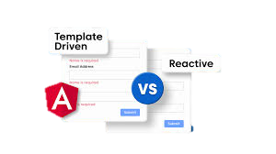
Introduction to Angular Forms
Forms are used to collect user input in web applications.
Angular provides two main form-building techniques:
Template-driven Forms
Reactive Forms

Slide 3
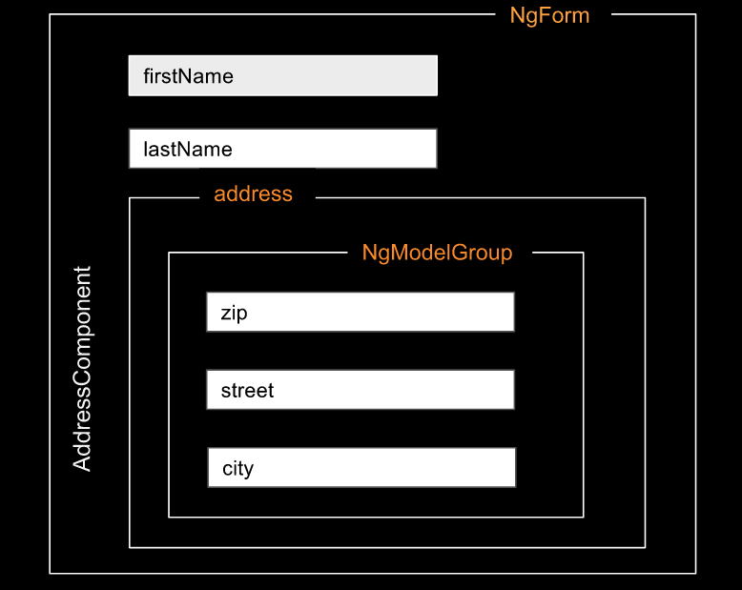
What are Template-driven Forms?
Built using directives in the template.
Relies heavily on Angular's two-way data binding (ngModel).
Form structure is defined within the HTML template.
Simpler and less code required for basic forms.

Slide 4

Key Features of Template-driven Forms
Easy to use:
Intuitive and suitable for simple forms.
Two-way Data Binding:
Automatic synchronization between model and view.
Asynchronous validation:
Validation occurs as the user interacts with the form.
Minimal TypeScript code:
Form logic resides mostly in the HTML template.

Slide 5
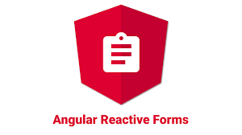
What are Reactive Forms?
Built using FormControl, FormGroup, and FormArray in TypeScript.
Uses explicit data handling through form control objects.
More flexible and suitable for complex forms.
Form structure is defined in TypeScript code, allowing dynamic form control creation.

Slide 6
Key Features of Reactive Forms
Declarative form structure:
Defined in TypeScript, more control over form fields.
Synchronous validation:
Immediate validation after user interaction.
Testability:
Better suited for unit testing.
Dynamic form creation:
Supports complex, dynamic forms through TypeScript code.

Slide 7
Template-driven vs Reactive Forms
Template-driven Forms
Reactive Forms
Setup Complexity: Simple.
Form Control Definition: In the template.
Two-way Data Binding: Yes (ngModel)
Validation: Synchronous
Suitable For: Simple forms
Testability: Difficult
Setup Complexity: Complex.
Form Control Definition: In typescript.
Two-way Data Binding: No (explicit sync)
Validation: Asynchronous
Suitable For: Complex, dynamic forms
Testability: Easy to test

Slide 8
Use Cases for Template-driven Forms
Simple forms with limited logic.
Forms with minimal validation.
Small-scale applications or prototypes.
Ideal for beginners.

Slide 9
Use Cases for Reactive Forms
Complex forms with advanced validation.
Forms requiring dynamic addition/removal of controls.
Forms with multi-step processes.
Applications where testability is a priority.

Slide 10
Advantages and Disadvantages
Template-driven Forms:
Pros: Easy to implement, less code.
Cons: Limited control, harder to test.
Reactive Forms:
Pros: More control, easier to test, flexible.
Cons: More code, higher complexity.

Slide 11

Conclusion
Both Template-driven and Reactive forms have their strengths.
Choose Template-driven for simplicity, Reactive for complexity and control.
Selecting the right form strategy depends on the complexity and scale of your project.

Slide 12
Thank You! Under the Guidance of Indrakka Mam Edubridge * Capgemini - Shridhar Pandey

